Slide 1
AI for Material Science:
Data Augmentation
for Graph Regression
Meng Jiang
Department of Computer Science and Engineering
University of Notre Dame

Slide 2
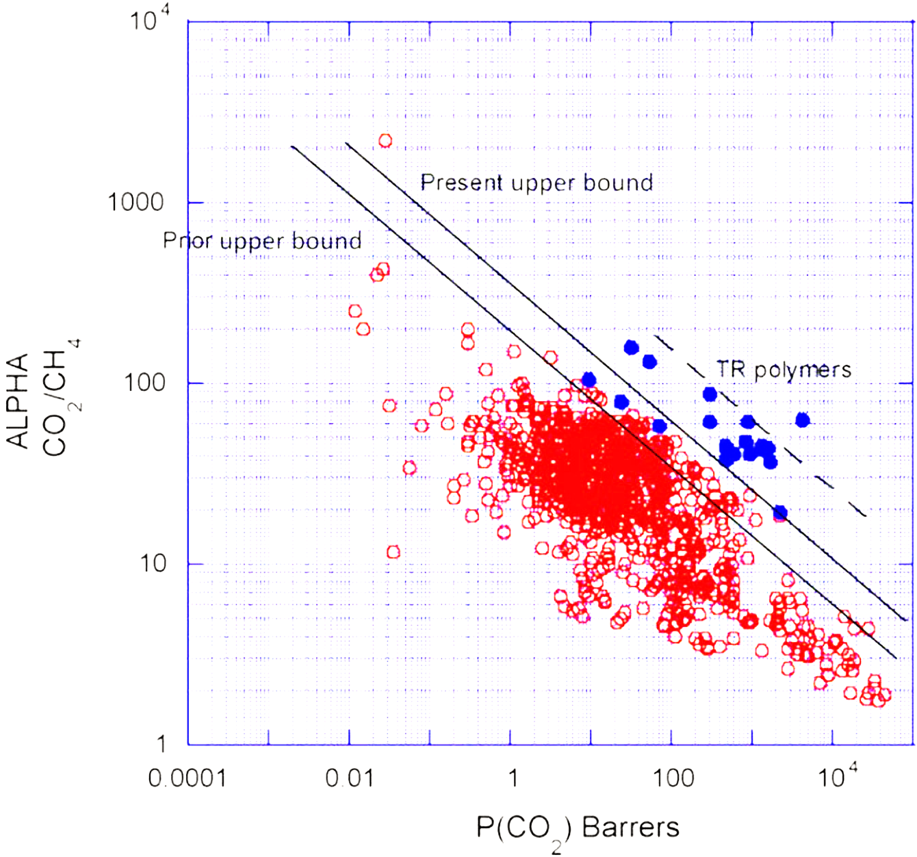
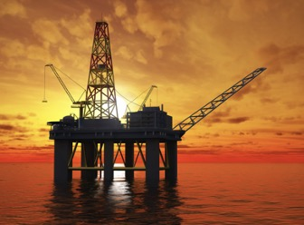
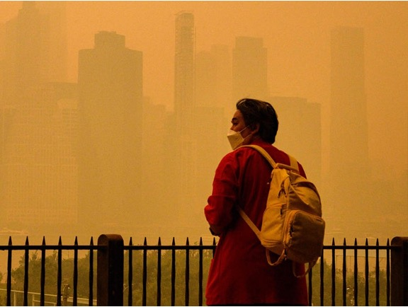
Gas-separation polymer membranes
Ideal polymer material
CO₂
CH₄
CO₂
Other gas
O₂
O₂
Selectivity
Permeability
Barnett et al. (2020). Designing exceptional gas-separation polymer membranes using machine learning. Science advances, 6(20), eaaz4301.

Slide 3
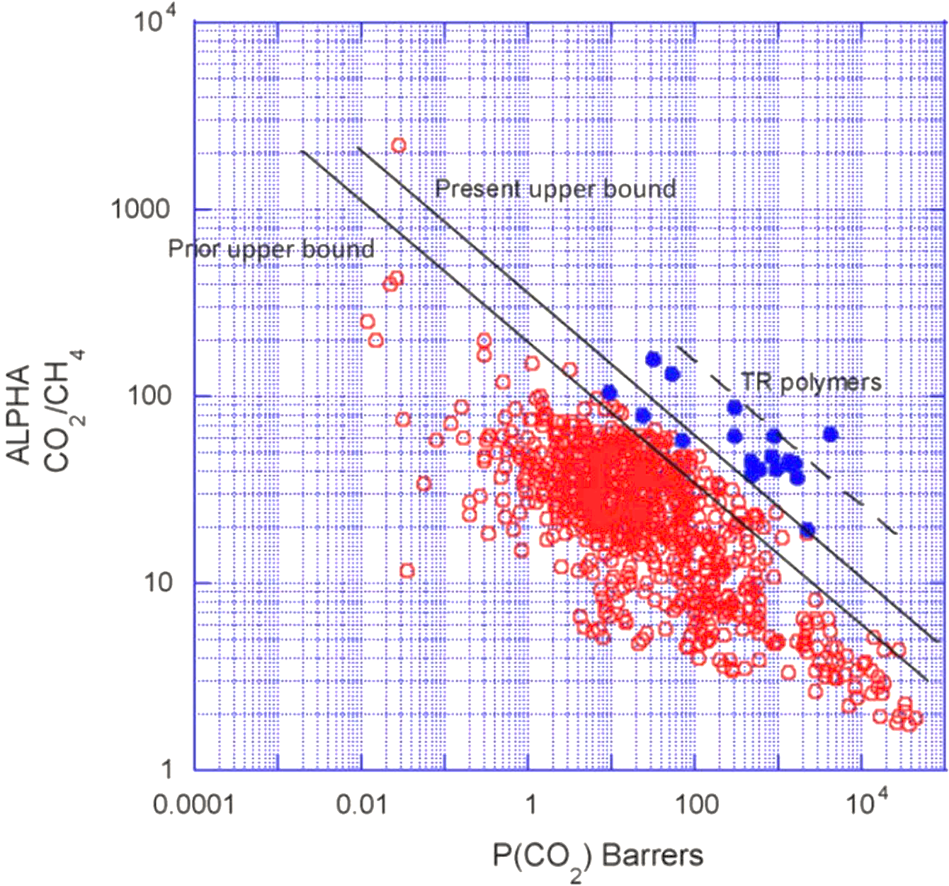
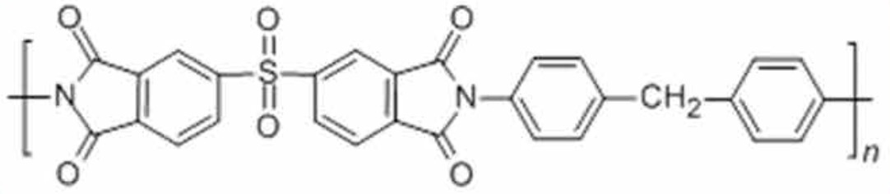
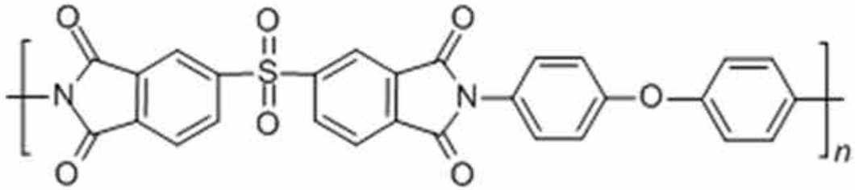
Research on polymer discovery
Red points: ~700 polymeric constructs that have been measured to date (60+ years)
1991 Robeson upper bound
Blue points: “Thermally rearranged (TR) polymers, which are considered the next-generation of membrane materials because of their excellent properties”
2008 Robeson upper bound
Selectivity
Permeability
Tena et al. (2016). Claisen thermally rearranged polymers. Science Advances, 2(7), e1501859.

Slide 4

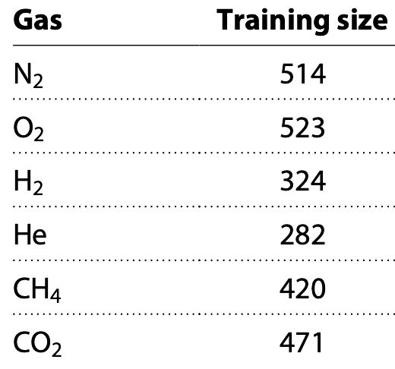
Research on Graph Regression
Research on polymer discovery
Supervised Learning: Training sets of ~500 examples are too limited.
Red points: ~700 polymeric constructs that have been measured to date (60+ years)
Blue points: “Thermally rearranged (TR) polymers, which are considered the next-generation of membrane materials because of their excellent properties”
Imbalanced Learning: Predictions on minor (continuous) labels are equally or more important than those on major labels.
DATA
Interesting but
hard to predict
Over 1.2 million
unlabeled points
Six different gases
Permeability
Transfer Learning: Any extra data points, no matter labeled or unlabeled, the same domain or different domains, could be useful.
Tena et al. (2016). ….
Science Advances, 2(7),
e1501859.

Slide 5
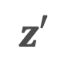
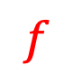

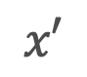
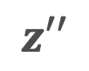
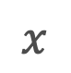
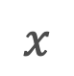
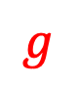
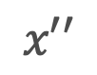
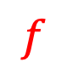
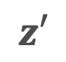
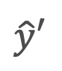
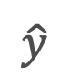
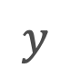
Data Augmentation
in Machine Learning
What is data augmentation?
Data augmentation techniques are used to increase the amount of data by adding slightly modified copies of existing data or newly created synthetic data from existing data. It helps reduce overfitting when training machine learning models. — Wikipedia [1]
Supervised learning Self-supervised learning
$$f$$
$$g$$
$$f$$
$$x$$
$$z$$
$$\hat{y}$$
$$y$$
augment
$$x′$$
$$z′$$
augment
$$x$$
$$x′$$
$$z′$$
$$\hat{y}′$$
$$x′′$$
$$z′′$$
[1] https://en.wikipedia.org/wiki/Data_augmentation

Slide 6
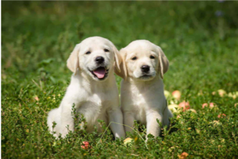
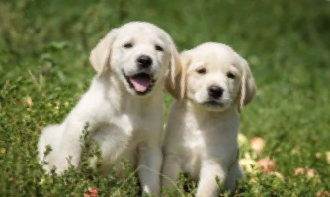
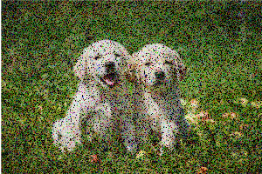
Data Augmentation
in Computer Vision and NLP
Cropping
Flipping
Data augmentation improved learning.
Image and text data could be augmented.
Heuristics were effective for augmentation.
Rotation
Add noise [1]
Synthetic nodes / links in a large graph?
Dependencies have to be learned to augment data.
“… awesome …”
“… amazing …”
Synonyms [2]
“amazing”
“awe-inspiring”
“awing”
…
[1] Zhong et al. “Random erasing data augmentation.” AAAI 2020.
[2] Wei et al. “EDA: Easy data augmentation techniques for boosting performance on text classification tasks.” EMNLP 2019.

Slide 7
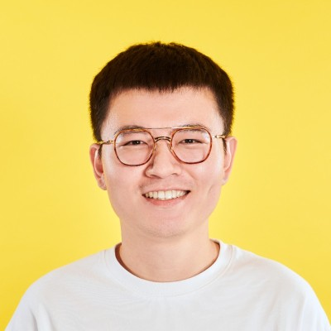
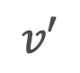
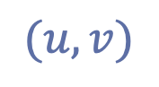
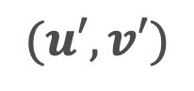

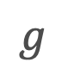
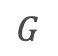
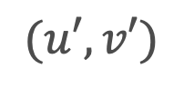
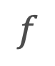
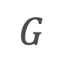
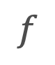
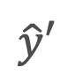
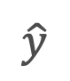
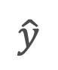
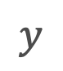
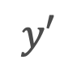
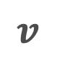

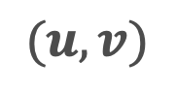
Data Augmentation for GNNs
AAAI’21, ICML’22, LoG’22
Tong Zhao (Snap)
$$G$$
$$g$$
Link prediction (addition and removal) created synthetic nodes in a large graph.
Improved node classification accuracy by relatively +17% [1].
Counterfactual link labels improved link prediction Hits@20 relatively by +16.4% [2].
Learning to augment is effective for graphs.
$$f$$
$$v$$
$$v$$
$$\hat{y}$$
$$y$$
Link predictor
$$v′$$
$$v′$$
$$\hat{y}′$$
$$f$$
arbitrary
$$(u,v)$$
$$(u,v)$$
$$\hat{y}$$
$$y′$$
$$G$$
Node pair matching
$$G$$
$$(u′,v′)$$
$$(u′,v′)$$
[1] Zhao et al. “Data augmentation for graph neural networks.” AAAI 2021.
[2] Zhao et al. “Learning from counterfactual links for link prediction.” ICML 2022.

Slide 8
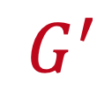

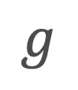
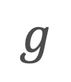
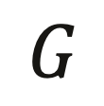
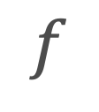
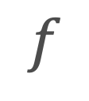
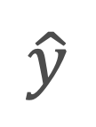
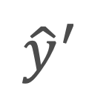
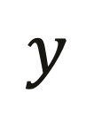
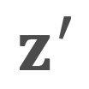
Research on Graph Regression
Graph Data Augmentation
Supervised Learning: Training sets of ~500 examples are too limited.
Techniques used to increase the amount of data by adding slightly modified copies of existing data or newly created synthetic data from existing data.
Imbalanced Learning: Predictions on minor (continuous) labels are equally or more important than those on major labels.
augment
$$G$$
$$G^{′}$$
Interesting but
hard to predict
Graph representation learning (via GNNs)
$$f$$
$$f$$
$$z$$
$$z^{′}$$
Regression function
$$g$$
$$g$$
Permeability
$$\hat{y}$$
$${\hat{y}}^{′}$$
Transfer Learning: Any extra data points, no matter labeled or unlabeled, the same domain or different domains, could be useful.
loss
loss
$$y$$
8

Slide 9




Data Augmentation for Graph Regression
augment
for Supervised Learning: Training sets of ~500 examples are too limited.
for Imbalanced Learning: Predictions on minor (continuous) labels are equally or more important than those on major labels.
for Transfer Learning: Any extra data points, no matter labeled or unlabeled, the same domain or different domains, can be useful.
$$G$$
$$G^{′}$$
$$f$$
$$f$$
$$z$$
$$z^{′}$$
$$g$$
$$g$$
$$\hat{y}$$
$${\hat{y}}^{′}$$
loss
loss
$$y$$

Slide 10

Graph Rationalization with Environment-based Augmentations
Washington D.C.
ACM SIGKDD Conference on Knowledge Discovery and Data Mining
Gang Liu, Tong Zhao, Jiaxin Xu, Tengfei Luo, Meng Jiang

Slide 11
What is Rationale?
Rationales and Environments
Rationale is defined as a subset of input features that best explains or supports the prediction by machine learning models.
Rationale identification improves the generalizability and interpretability of machine learning models on language and vision data.
Every time I order at the drive thru they make me park up and wait. Today I waited 20 mins and when my food arrived, it was stone cold.
negative
negative
I’ve just got home and one of my burgers was stone cold.
“Environments”
“Rationales”
I find that my French toast has a nice texture!
positive
Chocolate cake has a nice texture. I took a picture.
positive
Chang, et al. "Invariant rationalization." ICML, 2020.

Slide 12








Graph Rationalization
Graph Rationales and Environments
Graph rationale is defined as a subgraph of a molecule/polymer graph that best explains or supports property prediction.
Graph rationalization separates a graph $g$ into a rationale subgraph $g^{(r)}$and an environment subgraph $g^{(e)}$.
Rationale-Environment Separator $f_{sep}$
Rationale graph $g^{(r)}$
Environment graph $g^{(e)}$
Graph $g$

Slide 13








Baseline: Rationalization Improves Label Prediction
Identifying node roles: in Rationale or Environment?
$$1_{N}^{⊤}⋅\left(m×H\right)$$
MLP₂(·)
$${\hat{y}}_{i}^{(r)}$$
Label $y_{i}$
GNN₁(·)
MLP₁(·)
…
$$h_{i}^{(r)}$$
for Rationale $g_{i}^{(r)}$
$m$: Node’s probability of being classified into Rationale
Graph $g_{i}$
GNN₂(·)
…
$H$: Node representations
A model trained on ~500 examples could not effectively capture rationales.

Slide 14


Creating More Data Examples for Rationalization
How: if Rationales are the key factors of Labels, then …
Data Augmentation: Can you create one additional negative example?
Idea: Rationale of $i$+ Environment $j$: “I find that my French toast was stone cold!”
We apply this idea for graph rationalization and graph property prediction.
negative
$i:$I’ve just got home and one of my burgers was stone cold.
“Environments”
“Rationales”
$j:$I find that my French toast has a nice texture!
positive

Slide 15















GREA: Graph Rationale/Environment-based Augmentation
$$f_{sep}$$
$g_{i}^{(r)}$:
Augmentation by Environment Replacement
$g_{i}^{(e)}$:
$g_{(i;j)}=g_{i}^{(r)}∪g_{j}^{(e)}$
$$g_{i}$$
Graph | Label
$$g_{i}$$ | $$y_{i}$$
$$g_{j}$$ | $$y_{j}$$
$$g_{(i;j)}$$ | $$y_{i}$$
$$f_{sep}$$
$g_{j}^{(r)}$:
$g_{j}^{(e)}$:
$$g_{j}$$

Slide 16













Augmentation in Latent Space
Explicit subgraph decoding and encoding is technically challenging!
$$1_{N}^{⊤}⋅\left(m×H\right)$$
MLP₂(·)
$${\hat{y}}_{i}^{(r)}$$
Label $y_{i}$
GNN₁(·)
MLP₁(·)
…
$$h_{i}^{(r)}$$
for Rationale $g_{i}^{(r)}$
$m$: Node’s probability of being classified into Rationale
Graph $g_{i}$
…
AGG(·, ·)
MLP₂(·)
$${\hat{y}}_{(i;j)}$$
GNN₂(·)
$$1_{N}^{⊤}⋅\left((1_{N}−m)×H\right)$$
$$h_{i}^{(e)}$$
for Environment $g_{i}^{(e)}$
$H$: Node representations
$h_{(i;j)}$: Environment-replaced example $g_{(i;j)}=g_{i}^{(r)}∪g_{j}^{(e)}$
Graph $g_{j}$
…
$h_{j}^{(e)}$: Environment $g_{j}^{(e)}$

Slide 17




Experiments: Polymer Property Prediction (Regression)
Dataset | # Graphs | # Nodes / Graph
Graph | Graph | Mean | Max
GlassTemp | 7,174 | 36.7 | 166
MeltingTemp | 3,651 | 26.9 | 102
PolyDensity | 1,694 | 27.3 | 93
O₂Perm | 595 | 37.3 | 103
RMSE (Smaller is better) | GlassTemp | MeltingTemp | PolyDensity | O₂Perm
DIR (Wu et al. 2022) | 61.2 | 87.8 | 9.4 | 2,028
StableGNN (Fan et al. 2021) | 48.8 | 70.0 | 9.3 | 1,219
IRM (Arjovsky et al. 2019) | 46.1 | 64.2 | 9.0 | 770
U-NetsPool (Gao et al. 2021) | 44.9 | 63.4 | 10.0 | 865
SelfAttnPool (Lee et al. 2019) | 43.5 | 61.0 | 9.0 | 1,251
GREA w/o Replace | 60.6 | 64.0 | 9.0 | 1,556
GREA | 42.6 | 60.2 | 8.6 | 524
glass transition temperature (Tg)
melting temperature
The graph regression error was reduced (and R² was improved) on all the four tasks.
This was developed and evaluated on GCN (Kipf and Welling 2017).
Results on GIN (Xu et al. 2019) can be found in Table 2 of the paper.
polymer density
oxygen permeability

Slide 18
Experiments: Molecule Property Prediction (Classification)
Dataset | # Graphs | # Nodes / Graph
Graph | Graph | Mean | Max
HIV | 41,127 | 25.5 | 222
ToxCast | 8,576 | 18.8 | 124
Tox21 | 7,831 | 18.6 | 132
BBBP | 2,039 | 24.1 | 132
BACE | 1,513 | 34.1 | 97
ClinTox | 1,477 | 26.2 | 136
SIDER | 1,427 | 33.6 | 492
AUC (Higher is better) | HIV | ToxCast | Tox21 | BBBP
DIR | .7466 | .5954 | .4727 | .6559
StableGNN | .7218 | .6520 | .7454 | .6552
U-NetsPool | .7527 | .6507 | .7492 | .6709
SelfAttnPool | .7733 | .6510 | .7563 | .6602
IRM | .7702 | .6599 | .7654 | .6892
GREA w/o Replace | .7377 | .6614 | .7808 | .6736
GREA | .7794 | .6662 | .7822 | .6986
AUC | BACE | ClinTox | SIDER
DIR | .6751 | .6251 | .5331
StableGNN | .6607 | .7681 | .5644
U-NetsPool | .7757 | .8450 | .6181
SelfAttnPool | .7383 | .8291 | .5718
IRM | .7947 | .8819 | .6035
GREA w/o Replace | .7655 | .8708 | .6222
GREA | .8191 | .8961 | .6316
All the datasets were from the Open Graph Benchmark (ogbg): https://ogb.stanford.edu/docs/graphprop/
Consistent conclusions on Molecule:
Improvement
Across GNN architectures

Slide 19


Insights on Graph Rationalization
Data Augmentation for Supervised Learning
Data Augmentation can improve rationalization if training data is limited.
Rationalization improves accuracy and interpretability of graph regression.
Data Augmentation can be performed via representation vectors.

Slide 20
Data Augmentation for Graph Regression
augment
for Supervised Learning: Training sets of ~500 examples are too limited.
for Imbalanced Learning: Predictions on minor (continuous) labels are equally or more important than those on major labels.
for Transfer Learning: Any extra data points, no matter labeled or unlabeled, the same domain or different domains, can be useful.
$$G$$
$$G^{′}$$
$$f$$
$$f$$
$$z$$
$$z^{′}$$
$$g$$
$$g$$
$$\hat{y}$$
$${\hat{y}}^{′}$$
loss
loss
$$y$$

Slide 21

Semi-Supervised Graph Imbalanced Regression
Long Beach, CA
ACM SIGKDD Conference on Knowledge Discovery and Data Mining
Gang Liu, Tong Zhao, Eric Inae, Tengfei Luo, Meng Jiang

Slide 22
Imbalanced Label Distribution
Minorities Matter!
Ideal polymer material
500 labelled graphs
Selectivity
Selectivity
Given 1.2M unlabeled graphs, can we train GNNs with balanced data? And how?

Slide 23












Step 1: Self-Training for Imbalanced Learning
$$𝒢_{imb}$$
500
$$\{\left(G,y\right)\}$$
GNN$i$(·)
MLP$i$(·)
$$i=1,…,n$$
$$G$$
GNN$i$(·)
MLP$i$(·)
$$y±∆y$$
$$i=1,…,n$$
1.2M
Confidence: $σ=1−\frac{∆y}{\max\left(y,∆y\right)}∈[0,1]$
(data)
reverse
$$𝒢_{conf}$$
(method)
Sampling

Slide 24




Step 1: Self-Training for Imbalanced Learning
1.2M is not big enough?
Reasons:
Minorities are rarely predicted.
Predicted minorities are rarely confident.
Not balanced yet!
Unlabeled data
$${𝒢_{imb}∪𝒢}_{conf}$$
$${𝒢_{imb}∪𝒢}_{conf}$$
${𝒢_{imb}∪𝒢}_{conf}$ ${∪𝒢}_{aug}$
?
reverse
Balanced!

Slide 25












Step 2: Label-Anchored Augmentation for Balancing
Given an unpopular numeric label value, generate a molecule/polymer graph?
${𝒢_{imb}∪𝒢}_{conf}$ is too small to support a label-anchored graph generator.
$G∈{𝒢_{imb}∪𝒢}_{conf}$
GNN (·)
$$h∈ℝ^{d}$$
MLP (·)
$$y∈ℝ$$
$$H_{aug}$$
$$G∈𝒢_{aug}$$
GNN (·)
$$h$$
MLP (·)
$$\tilde{y}$$
Data Augmentation
Graph Generator

Slide 26






Step 2: Label-Anchored Augmentation for Balancing
Mixing-up graph representations for a given label value!
Given $\tilde{y}$
Given a given label value $\tilde{y}$:
1. Sample a labeled example $\left(G_{j}{{∈𝒢}_{imb}∪𝒢}_{conf},y_{j}\right)$
2. Get $h_{j}=GNN(G_{j})$
3. Sample a label interval $\left(z_{i},a_{i}\right)$
4. Constrain the sampling processes:
$\tilde{h}=$ $λ∙z_{i}+(1−λ)∙h_{j}$
s.t. $\tilde{y}=λ∙a_{i}+(1−λ)∙y_{j}$
5. Augment with $\left(\tilde{h},\tilde{y}\right)$
$i$-th label interval
$$z_{i}=mean(\left\{h\right\})$$
$$a_{i}=mean(\{y\})$$
$$1,2,3,…$$
$$…,C$$

Slide 27















Framework & Optimization
$$𝒢_{imb}$$
$$𝒢_{imb}∪𝒢_{conf}$$
$${𝒢_{imb}∪𝒢}_{conf} {∪H}_{aug}$$
$$𝒢_{unlabel}$$
$$𝒢_{conf}$$
$$H_{imb}∪H_{conf}$$
$$H_{aug}$$
$G∈{𝒢_{imb}∪𝒢}_{conf}$
GNN (·)
$$h∈ℝ^{d}$$
MLP (·)
$$y∈ℝ$$
$$h∈H_{aug}$$
MLP (·)
$$y∈ℝ$$
$$ℒ=\sum_{(G∈{𝒢_{imb}∪𝒢}_{conf},y)}{ℒ_{GNN/MLP}(G,y)}+\sum_{(h∈H_{aug} ,y)}{ℒ_{MLP}(h,y)}$$

Slide 28

Experiments: Imbalanced Graph Regression
Dataset | # Graphs | # Nodes / Graph
Graph | Graph | Mean | Max
Molecule Datasets: | 7,174 | 36.7 | 166
Lipo | 4,200 | 27.0 | 115
ESOL | 1,128 | 13.3 | 55
FreeSolv | 642 | 8.7 | 24
Polymer Datasets: | 7,174 | 36.7 | 166
MeltingTemp | 3,651 | 26.9 | 102
PolyDensity | 1,694 | 27.3 | 93
O₂Perm | 595 | 37.3 | 103
Many-shot, Medium-shot, Few-shot
Evaluated by Mean Absolute Error (MAE). Smaller is better.
More shots, smaller errors.
Can our framework achieve smaller errors, both generally and specifically for the few-shot region?
Notes:
Lipophilicity: Experimental results of octanol/water distribution coefficient (logD at pH 7.4).
ESOL: Water solubility data(log solubility in mols per litre) for common organic small molecules.
FreeSolv: Experimental and calculated hydration free energy of small molecules in water.

Slide 29
Experiments: Molecule Property Prediction
MAE (Smaller is better) | Lipo |  |  |  | ESOL |  |  |  | FreeSolv
 | All | Many- shot | Med.- shot | Few- shot | All | Many- shot | Med.- shot | Few- shot | All | Many- shot | Med.- shot | Few- shot
GIN (Xu et al. 2019) | .485 | .421 | .462 | .566 | .508 | .398 | .448 | .696 | .726 | .617 | .695 | 1.154
RankSim (Gong et al. 2022) | .475 | .388 | .438 | .587 | .501 | .389 | .443 | .689 | .779 | .764 | .674 | 1.220
BMSE (Ren et al. 2022) | .494 | .409 | .450 | .614 | .533 | .400 | .449 | .777 | .856 | .809 | .820 | 1.122
LDS (Yang et al. 2021) | .468 | .394 | .449 | .551 | .517 | .423 | .474 | .668 | .809 | .796 | .737 | 1.114
InfoGraph (Sun et al. 2020) | .499 | .421 | .471 | .596 | .561 | .475 | .466 | .776 | .933 | .830 | .913 | 1.308
GREA (Liu et al. 2022) | .487 | .391 | .434 | .626 | .497 | .396 | .456 | .652 | .642 | .541 | .570 | 1.202
SGIR | .432 | .357 | .413 | .515 | .457 | .370 | .411 | .604 | .563 | .535 | .528 | .777
Zhenqin Wu, Bharath Ramsundar, Evan N Feinberg, Joseph Gomes, Caleb Geniesse, Aneesh S Pappu, Karl Leswing, and Vijay Pande. 2018. MoleculeNet: a benchmark for molecular machine learning. Chemical science 9, 2 (2018), 513–530.

Slide 30
Experiments: Polymer Property Prediction
MAE (Smaller is better) | MeltingTemp |  |  |  | PolyDensity |  |  |  | O₂Perm
 | All | Many- shot | Med.- shot | Few- shot | All | Many- shot | Med.- shot | Few- shot | All | Many- shot | Med.- shot | Few- shot
GIN (Xu et al. 2019) | 41.8 | 35.5 | 33.0 | 54.7 | 61.2 | 63.4 | 46.6 | 72.0 | 183.5 | 6.3 | 14.6 | 464.0
RankSim (Gong et al. 2022) | 41.1 | 34.1 | 33.6 | 53.5 | 57.5 | 55.1 | 46.3 | 69.4 | 165.7 | 3.9 | 13.0 | 420.7
BMSE (Ren et al. 2022) | 42.1 | 35.8 | 34.1 | 54.5 | 61.8 | 59.1 | 48.2 | 75.9 | 190.4 | 26.4 | 27.0 | 454.3
LDS (Yang et al. 2021) | 41.6 | 35.3 | 34.5 | 53.2 | 60.1 | 60.4 | 47.0 | 71.3 | 180.0 | 6.6 | 11.8 | 456.3
InfoGraph (Sun et al. 2020) | 43.6 | 35.3 | 35.0 | 58.3 | 54.9 | 46.8 | 43.0 | 72.3 | 199.5 | 7.5 | 13.0 | 505.5
GREA (Liu et al. 2022) | 41.2 | 33.3 | 32.7 | 55.3 | 60.4 | 49.0 | 48.1 | 80.7 | 182.5 | 9.0 | 14.4 | 458.8
SGIR | 38.9 | 31.7 | 31.5 | 51.4 | 53.0 | 45.4 | 42.5 | 68.6 | 150.9 | 3.8 | 12.2 | 382.8
Gang Liu, Tong Zhao, Jiaxin Xu, Tengfei Luo, and Meng Jiang. "Graph rationalization with environment-based augmentations." In Proceedings of the 28th ACM SIGKDD Conference on Knowledge Discovery and Data Mining, pp. 1069-1078. 2022.

Slide 31

Experiments: Ablation Study
MAE | Lipo |  |  |  | ESOL |  |  |  | FreeSolv
 | All | Many- | Med.- | Few- | All | Many- | Med.- | Few- | All | Many- | Med.- | Few-
$$𝒢_{imb}$$ | .477 | .378 | .440 | .600 | .477 | .375 | .432 | .637 | .619 | .525 | .590 | 1.000
$${𝒢_{imb}∪𝒢}_{conf}$$ | .442 | .372 | .415 | .533 | .468 | .379 | .425 | .612 | .568 | .538 | .520 | .831
$$𝒢_{imb}{∪H}_{aug}$$ | .456 | .372 | .436 | .549 | .474 | .353 | .450 | .623 | .593 | .536 | .542 | .947
$${𝒢_{imb}∪𝒢}_{conf} {∪H}_{aug}$$ | .432 | .357 | .413 | .515 | .457 | .370 | .411 | .604 | .563 | .535 | .528 | .777
Take Away from this Work
Improving regression performance in few-shot regions is challenging.
Data Augmentation alleviates training data imbalance, when self-training suffers from lack of confidence on predicting minor labels.
Again, Data Augmentation can be performed via representation vectors.

Slide 32
Data Augmentation for Graph Regression
augment
for Supervised Learning: Training sets of ~500 examples are too limited.
for Imbalanced Learning: Predictions on minor (continuous) labels are equally or more important than those on major labels.
for Transfer Learning: Any extra data points, no matter labeled or unlabeled, the same domain or different domains, can be useful.
$$G$$
$$G^{′}$$
$$f$$
$$f$$
$$z$$
$$z^{′}$$
$$g$$
$$g$$
$$\hat{y}$$
$${\hat{y}}^{′}$$
loss
loss
$$y$$

Slide 33

Data-Centric Learning from Unlabeled Graphs with Diffusion Model
New Orleans, LA
The Conference on Neural Information Processing Systems
Gang Liu, Eric Inae, Tong Zhao, Jiaxin Xu, Tengfei Luo, Meng Jiang

Slide 34
Parameter-Centric Transfer
i.e., self-supervised learning on unlabeled graphs
Knowledge from self-supervised tasks could not be aligned or even conflicting with downstream predictions.
Parameter initialization could hardly interpret how unlabeled graphs were able to improve the prediction models.
Context prediction task: (Reconstruction) | Aromatic rings ~ Prevalent structure (Maziarka et al. 2020; Zhang et al. 2021)
Property prediction task: | Non-aromatic rings ~ O₂ Permeability (Liu et al. 2022)
Contrastive learning task: | (Original graph, Perturbed graph)
Property prediction task: (No universal perturbations) | Bioisosteric replacement: Maintain biological properties Reduce toxicity (Brown et al. 2014)

Slide 35
Data-Centric Transfer
Parameter-Centric Transfer
Adapt knowledge in unlabeled data to target tasks
Interpret transferred knowledge with observable data
Expert can evaluate and control the transfer

Slide 36


Data-Centric Transfer
Based on Diffusion Probabilistic Model – a Generative Model on Graphs
Diffusion process
Denoising process
Sufficiency for Data Augmentation: The augmented graph $G^{′}$sufficiently preserves the label of the original graph $y$
$$\min_{L_{1}}{\max_{L_{2}}{𝔼_{G}[L_{1}\left(G^{′};G\right)+L_{2}(G^{′};y)]}}$$
Minimal Sufficiency for Data Augmentation: The sufficiency is minimal if and only if $I\left(G^{′};G\right)≤I(\overline{G};G)$, $∀\overline{G}$, where $I(;)$ is mutual information.

Slide 37

Negative impact

Slide 38

Negative impact

Slide 39
Insights on Data-Centric Transfer
Data Augmentation for Transfer Learning
Parameter-centric transfer is fragile: It’s hard to perform self-supervised learning on unlabeled graphs to benefit downstream tasks. Because the self-supervised tasks may not extract the knowledge needed for property prediction.
Data-centric transfer adapts the knowledge in unlabeled graphs to target domain. It augments the labeled data in the target domain.
Data augmentation can be implemented via diffusion model. It is optimized by the minimal sufficiency principle: labeled graphs guide the de-noising process.

Slide 40

Graph Diffusion Transformers (Graph DiT) for Multi-Conditional Molecular Generation
Vancouver, Canada
The Conference on Neural Information Processing Systems
Gang Liu, Jiaxin Xu, Tengfei Luo, Meng Jiang

Slide 41








Graph Diffusion Transformer
Guide Graph Generation (Denoising Process) with Representations of Conditions
Molecular Properties
$$𝒞$$
…
Synthesizability : High Value
O2 Permeability: High Value
N2 Permeability : Low Value
Multi-Head Attention
Numerical
Categorical
Adaptive Layer Normal.
Clustering Encoding
One-Hot Encoding
MLP
Adaptive Layer Normal.
Representations of conditions
Random Noise
Guide
$G$^{(T)}
$G$^{(T-1)}
…
$G$⁽¹⁾
$G$⁽⁰⁾
$$p_{θ}(G^{(t−1)}∣G^{(t)}, 𝒞)$$

Slide 42





Inverse Polymer Design
Synth.
O2 Perm
N2 Perm
Synth.
O2 Perm
N2 Perm
Generate 30 examples per property
(90 in total)
Generate 30 examples in total
…
…
…
Ground truth:
If in,
return rank
If not in,
return 30
If not in,
return 30
…
…
…
Median across
the test set: 30
rank
rank
rank
Median=4
Median=9
Median=11

Slide 43
Summary
augment
for Supervised Learning: Training sets of ~500 examples are too limited.
Environment-based Augmentations
for Imbalanced Learning: Predictions on minor (continuous) labels are equally or more important than those on major labels.
Label-anchored Augmentation
for Transfer Learning: Any extra data points, no matter labeled or unlabeled, the same domain or different domains, can be useful.
Data-Centric Transfer
Graph Diffusion Transformer
$$G$$
$$G^{′}$$
$$f$$
$$f$$
$$z$$
$$z^{′}$$
$$g$$
$$g$$
$$\hat{y}$$
$${\hat{y}}^{′}$$
loss
loss
$$y$$

Slide 44

Torch-Molecule
https://github.com/liugangcode/torch-molecule
torch-molecule is a package under active development that facilitates molecular discovery through deep learning, featuring a user-friendly, sklearn-style interface. It includes model checkpoints for efficient deployment and molecular/polymer task. The package has three components:
Predictive Models: GCN, GIN, GREA, SGIR, IRM, DIR; SMILES-based LSTM and Transformers.
Generative Models: GraphGA, DiGress, GDSS, Graph DiT.
Representation Models: MoAMa, AttrMasking, ContextPred, EdgePred.

Slide 45


Bridging Communities with Textbooks
Machine Learning / AI + Materials Discovery / Mech. and Chem. Engineering
For undergraduate programs
For graduate programs
Scientific primer: “American Chemical Society (ACS)
In Focus”

Slide 46




Multimodal Large Language Models
Inverse Molecular Design with Retrosynthetic Planning [Liu et al. ICLR 2025]
LLM
Graph Modules
Llamole
“To satisfy the requirements: The molecule is a complex, aromatic compound… It is”
Benchmarking:
PubChem (158K)
MoleculeNet (492K)
ThermCond (<1K)
MSA (<1K)
ChEMBL (2.2M)
ZINC (4M)
PI1M (1M)
FFV (8K)
USPTO (3.8M)
Small Molecule
Polymeric Materials
Reaction

Slide 47


Gang Liu
Foundation Models Lab
On the Academic Market!
Lucy Family Institute for Data & Society
The hero behind all the work in this talk.
Received IBM PhD Fellowship 2024-2025.
Multiple PhD & Postdoc positions!

Slide 48
Welcome to visit our lab!
http://www.meng-jiang.com/lab.html
https://github.com/DM2-ND
mjiang2@nd.edu
The work in this talk was supported by NSF IIS-2142827, IIS-2146761, IIS-2234058, CBET-2332270,
ONR N00014-22-1-2507, and IBM PhD Fellowship 2024.

